Slide 1


Green Pace
Security Policy Presentation
Developer: Corey Sampson
Date: April 17, 2025
Presentation Link:
Notes:
Hello, my name is Corey Sampson. This presentation introduces the Green Pace Security Policy Guide. This guide is designed to ensure consistent application of modern security best practices in both coding and systems architecture.

Slide 2

OVERVIEW: DEFENSE IN DEPTH
Green Pace requires standardized security policies due to a growing development team.
Policies are based on principles, standards, and automated enforcement.
They ensure consistency, compliance, and protection using the defense-in-depth strategy.
Notes:
As a development team expands, standardized security policies become more essential. These policies are grounded in industry-accepted principles and coding standards, enforced through automation in continuous integration and continuous delivery pipelines (CI/CD). This supports the overarching defense-in-depth strategy, promoting consistency, compliance, and reduced risk of vulnerabilities.

Slide 3
THREATS MATRIX
Likely -Data Type -Data Value -Exceptions | Priority -String Correctness -SQL Injection -Memory Protection
Low priority -Thread Safety -Pointer Safety -Cryptography | Unlikely -Assertions
Threat levels guide remediation priorities.
High-priority standards are enforced through CI/CD automation tools.
Notes:
The Threat Matrix categorizes each identified vulnerability by likelihood and priority for mitigation. For example, data type and exception handling are classified as “Likely,” while SQL injection and string correctness are labeled “Priority.” Lower-priority risks, such as pointer safety and cryptography, remain important but are less urgent. Automation tools such as static analyzers flag these issues based on severity to enable prioritized remediation.

Slide 4
10 PRINCIPLES
Validate Input Data
Heed Compiler Warnings
Architect and Design for Security
Keep It Simple
Default Deny
Principle of Least Privilege
Sanitize External Data
Practice Defense in Depth (DiD)
Use Effective Quality Assurance Techniques
Adopt Secure Coding Standards
Notes:
The Green Pace Security Policy is based on ten core principles:
Validating Data Input – Ensuring all user input is properly checked to prevent injection attacks and buffer overflows.
Heeding Compiler Warnings – Treating compiler warnings as potential vulnerabilities and addressing them proactively.
Architecture and Design for Security – Incorporating security requirements into the design phase to enforce a stronger architecture.
Keeping It Simple – Reducing complexity, making the system easier to secure and maintain.
Default Denying – Granting access only when explicitly authorized to reduce unauthorized use.
Principle of Least Privilege – Limiting user and process permissions to the minimum necessary.
Sanitizing External Data – Cleaning data shared across systems to prevent injection attacks.
Practicing Defense-in-Depth – Implementing multiple layers of security for redundancy and resilience.
Using Effective Quality Assurance Techniques – Employing rigorous testing, including code reviews, and penetration testing.
Adopting Secure Coding Standards – Applying industry best practices such as SEI CERT C++ to reduce vulnerabilities.
Each principle aligns with specific coding standards to enforce them in practice.

Slide 5
CODING STANDARDS
Data Type Safety(STD-001-CPP) – Ensure correct use of data types.
Data Value Initialization(STD-002-CPP) – Prevent use of uninitialized or incorrect data values.
String Correctness(STD-003-CPP) – Prevent buffer overflows and improper string handling.
SQL Injection Protection(STD-004-CPP) – Prevent SQL injection attacks by using parameterized queries.
Memory Protection(STD-005-CPP) – Prevent memory leaks and unauthorized access.
Assertions(STD-006-CPP) – Ensure code correctness, validate assumptions.
Exception Handling(STD-007-CPP) – Improve error handling with exceptions instead of error codes.
Thread Safety(STD-008-CPP) – Prevent race conditions and deadlocks in multithreaded applications.
Pointer Safety(STD-009-CPP) – Avoid dangling pointers and memory corruption.
Cryptography(STD-010-CPP) – Ensure secure data encryption and hashing.
Notes:
The ten coding standards that are prioritized include:
Data Type Safety – Ensures correct use of data types to prevent confusion and memory corruption.
Data Value Initialization – Prevents use of uninitialized or incorrect data values.
String Correctness – Prevents buffer overflows and improper string handling.
SQL Injection Protection – Prevents SQL Injection attacks by using parameterized queries.
Memory Protection – Prevents memory leaks and unauthorized access.
Assertions – Ensures code correctness by validating assumptions.
Exception Handling – Improves error handling by using exceptions instead of error codes.
Thread Safety – Prevents race conditions and deadlocks in multithreaded applications.
Pointer Safety – Avoids dangling pointers and memory corruption.
Cryptography – Ensures secure data encryption and hashing.
Prioritization is based on exploitability and impact. Top concerns, such as data integrity and injection attacks, receive the highest attention.

Slide 6
ENCRYPTION POLICIES
In Transit (In Flight): TLS 1.3 or newer for all communications.
At Rest: AES-256 encryption for databases, logs, backups.
In Use: Memory encryption via TEE, AMD SEV, Intel SGX.
Why: Prevent data theft, ensure compliance, and mitigate breach damage.
Notes:
To protect sensitive data:
In Transit: Transport Layer Security (TLS) version 1.3 is used for secure communication.
At Rest: Advanced Encryption Standard (AES-256) 256-bit is used for all data storage.
In Use: Intel SGX and AMD SEV provide hardware-based memory protection.
This layered approach prevents data theft and ensures regulatory compliance.

Slide 7
TRIPLE-A POLICIES
Authentication: Multi-Factor Authentication (MFA) and Single Sign-On (SSO). Enforce at login portals and API access points. Prevent unauthorized access.
Authorization: Role-Based Access Control (RBAC). Users only gain access to systems and files necessary for their specified role. Limit the scope of potential damage in case of a breach.
Accounting: Track activity via centralized logging (i.e., SIEM tools). Capture login attempts, data access, record changes, and admin actions. Supports incident response and audits.
Notes:
Authentication, authorization, and accounting policies consist of:
Multi-Factor Authentication (MFA) and Single Sign-On (SSO) to secure access points.
Role-Based Access Control (RBAC) to limit permissions based on user roles.
Centralized logging using Security Information and Event Management (SIEM) tools to capture all critical activity.
These measures enhance security and accountability.

Slide 8
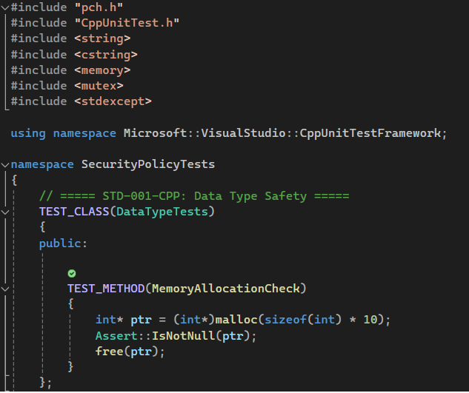
Unit Testing STD-001-CPP: Data Type Safety
Test Overview:
Validates dynamic memory allocation using malloc.
Ensures allocated memory is not null.
Key Points:
Basic Test: Tests if memory allocation is successful.
Take it a Step Further: Extend to test different types of memory allocation (i.e., new operator, std::vector).
Unit Testing Framework (CppUnitTest): Use Assert::IsNotNull() to check memory allocation success.
Notes:
This unit test validates dynamic memory allocation using the malloc function. It ensures that the allocated memory is not null. The basic test confirms successful memory allocation. An advanced version tests different types of memory allocation, such as the new operator and the standard vector container. The Microsoft C++ Unit Testing Framework (CppUnitTest) uses Assert::IsNotNull to confirm allocation success.

Slide 9
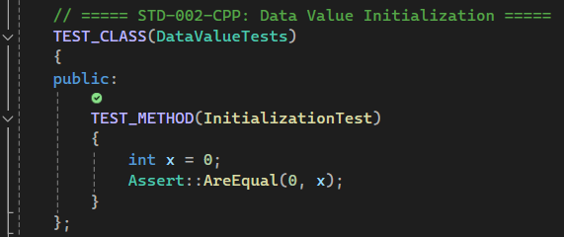
Unit Testing STD-002-CPP: Data Value Initialization
Test Overview:
Ensures variables are initialized correctly.
Key Points:
Basic Test: Checks if an integer variable is initialized to zero.
Take it a Step Further: Add tests for different data types (i.e., floating-point, strings).
Unit Testing Framework (CppUnitTest): Use Assert::AreEqual() to compare expected and actual values.
Notes:
This unit test checks that variables are properly initialized. The basic test verifies that an integer is set to zero. Additional tests can assess initialization for other data types such as floating-point numbers and character strings. Assert::AreEqual is used in the Microsoft C++ Unit Testing Framework to compare expected and actual values.

Slide 10
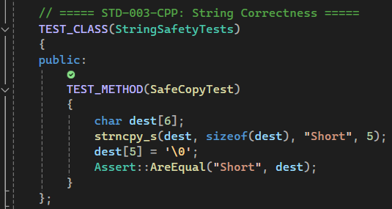
Unit Testing STD-003-CPP: String Correctness
Test Overview:
Validates that strings are safely copied using strncpy_s.
Key Points:
Basic Test: Verifies safe string copy.
Take it a Step Further: Add more tests to handle buffer overflows and invalid inputs.
Unit Testing Framework (CppUnitTest): Use Assert::AreEqual() for comparing the source and destination strings.
Notes:
This unit test verifies the safe copying of character strings using the strncpy_s function. The basic test confirms that a string has been safely copied. Expanded testing includes handling buffer overflows and invalid input values. Assert::AreEqual is used to compare the original and copied strings.

Slide 11
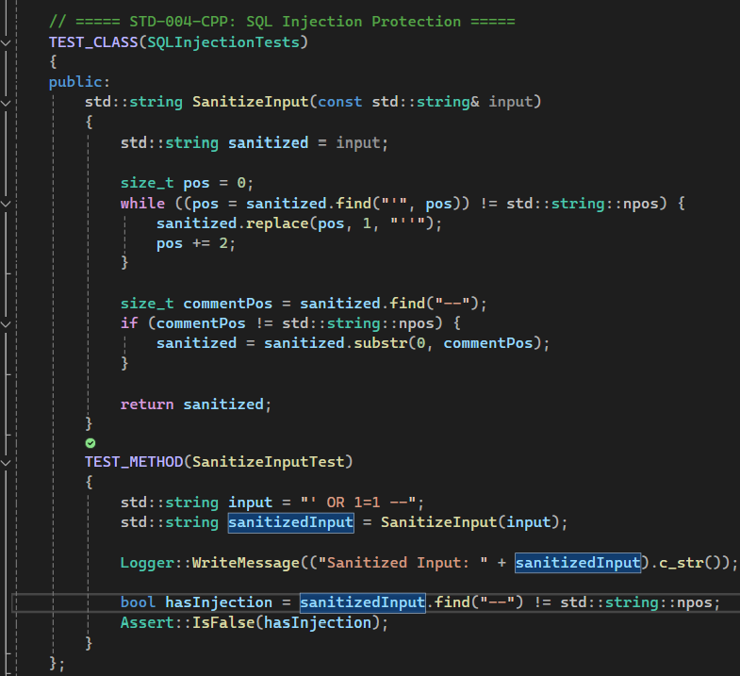
Unit Testing STD-004-CPP: SQL Injection Protection
Test Overview:
Sanitizes input to prevent SQL Injection.
Key Points:
Basic Test: Tests that SQL injection characters are sanitized.
Take it a Step Further: Implement additional filters for other dangerous characters or patterns.
Unit Testing Framework (CppUnitTest): Use Assert::IsFalse() to ensure injected code doesn’t appear in the sanitized input.
Notes:
This unit test sanitizes input to prevent SQL injection. The basic test checks that potentially malicious characters are removed or neutralized. Further testing can involve additional filtering for other dangerous characters and injection patterns. Assert::IsFalse ensures that no injected code appears in the sanitized output.

Slide 12
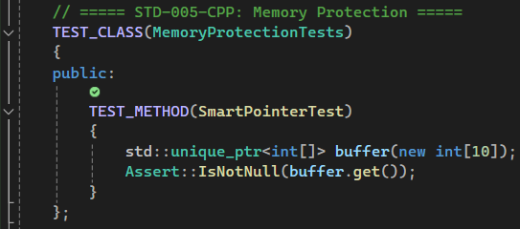
Unit Testing STD-005-CPP: Memory Protection
Test Overview:
Validates memory protection using smart pointers (i.e., std::unique_ptr).
Key Points:
Basic Test: Ensures the smart pointer is not null.
Take it a Step Further: Test with different types of smart pointers such as std::shared_ptr.
Unit Testing Framework (CppUnitTest): Use Assert::IsNotNull() for validating that the smart pointer has successfully allocated memory.
Notes:
This unit test uses smart pointers, such as standard unique pointers, to ensure memory protection. The basic test verifies that the smart pointer is not null after allocation. More advanced tests include the use of standard shared pointers. Assert::IsNotNull confirms that memory has been allocated safely.

Slide 13
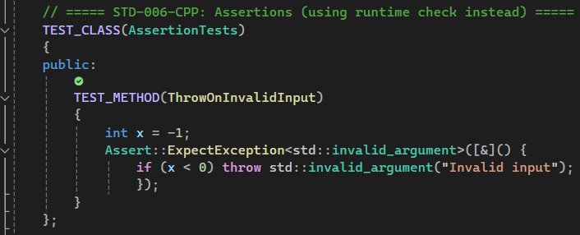
Unit Testing STD-006-CPP: Assertions
Test Overview:
Demonstrates runtime checks with assertions.
Key Points:
Basic Test: Verifies throwing an exception when invalid input is checked.
Take it a Step Further: Test multiple exception types and add custom exception classes.
Unit Testing Framework (CppUnitTest): Use Assert::ExpectException() to test for exceptions.
Notes:
This unit test demonstrates runtime checks through assertions. The basic test checks that an exception is thrown when invalid input is processed. Additional tests can involve various types of exceptions and custom exception classes. The Microsoft C++ Unit Testing Framework uses Assert::ExpectException for these tests.

Slide 14
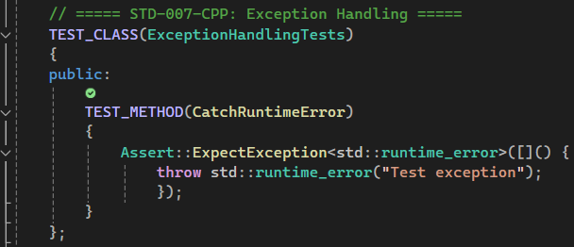
Unit Testing STD-007-CPP: Exception Handling
Test Overview:
Tests if runtime exceptions are properly caught.
Key Points:
Basic Test: Verifies that the correct exception is thrown.
Take it a Step Further: Test for specific exception types and check exception messages.
Unit Testing Framework (CppUnitTest): Use Assert::ExpectException() to catch exceptions.
Notes:
This unit test ensures proper handling of runtime exceptions. The basic test confirms that the correct exception is thrown. Additional coverage may include testing specific exception types and validating associated messages. Assert::ExpectException is used to verify exception handling.

Slide 15
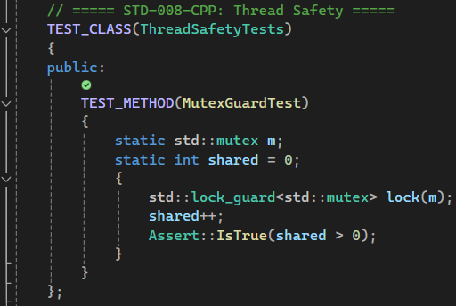
Unit Testing STD-008-CPP: Thread Safety
Test Overview:
Validates thread safety by using std::mutex and std::lock_guard.
Key Points:
Basic Test: Tests that a shared variable is protected by a mutex.
Take it a Step Further: Add additional tests to verify thread safety under concurrent execution.
Unit Testing Framework (CppUnitTest): Use Assert::IsTrue() to verify thread protection.
Notes:
This unit test validates thread safety by using standard mutex and lock guard mechanisms. The basic test checks that a shared variable is accessed safely under a mutex. Expanded tests can evaluate protection under concurrent execution scenarios. Assert::IsTrue confirms that thread safety measures are effective.

Slide 16
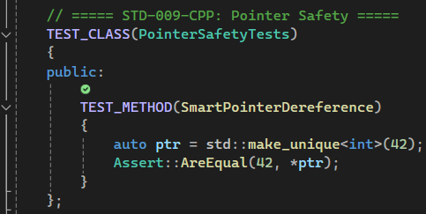
Unit Testing STD-009-CPP: Pointer Safety
Test Overview:
Tests dereferencing of a smart pointer for safety.
Key Points:
Basic Test: Ensures safe dereferencing of smart pointers.
Take it a Step Further: Test with different smart pointer types and edge cases.
Unit Testing Framework (CppUnitTest): Use Assert::AreEqual() to verify the value of the dereferenced pointer.
Notes:
This unit test ensures that smart pointers are dereferenced safely. The basic test verifies that dereferencing yields the expected value. Additional testing may explore different smart pointer types and edge case behaviors. Assert::AreEqual checks that dereferencing works as intended.

Slide 17
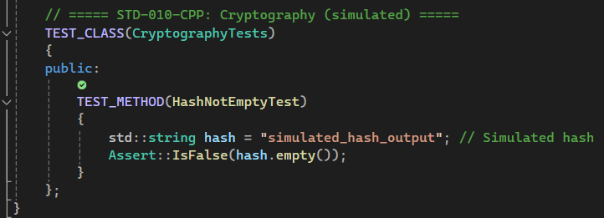
Unit Testing STD-010-CPP: Cryptography (Simulated)
Test Overview:
Simulates a hash check to ensure it is not empty.
Key Points:
Basic Test: Ensures that the simulated hash value is not empty.
Take it a Step Further: Implement actual cryptographic functions and test hash integrity.
Unit Testing Framework (CppUnitTest): Use Assert::IsFalse() to check that the has is not empty.
Notes:
This unit test simulates a hash check to ensure that it is not empty. The basic test verifies that the resulting hash value is not empty. Advanced testing could implement actual cryptographic functions to verify hash integrity. Assert::IsFalse confirms that the simulated hash is not empty.

Slide 18

AUTOMATION SUMMARY
Notes:
Automated testing and analysis occur at multiple points:
Commit via Git hooks
CI/CD delivery, build, and test stages
Staging with scheduled scans
These checkpoints help detect vulnerabilities early and reduce reliance on manual review. Tools like SonarQube and Coverity enforce SEI CERT and CWE rulesets automatically. Any violations are logged and halt the CI/CD pipeline until resolution.

Slide 19
TOOLS
The DevSecOps pipeline is a constantly evolving and developing system that integrates security through the entire Software Development Lifecycle (SDLC) and live portions of the product.
Security Tools (i.e., SonarQube, Cppcheck, etc.) are triggered at:
Commit: Git hooks
Build/Test: CI pipeline checks
Staging: Periodic security scans
Notes:
Tools such as SonarQube and Cppcheck are part of the DevSecOps pipeline. Security checks are embedded into all key stages to prevent vulnerabilities from progressing to production. Early notifications help improve overall code quality.

Slide 20
PROBLEMS AND SOLUTIONS
Problems:
Inconsistent use of safe coding practices across the development team.
Lack of centralized enforcement of SEI CERT C++ standards.
Potential for serious vulnerabilities such as memory corruption, buffer overflows, and injection attacks.
Increased risk of breaches as the team grows and the codebase scales.
Solutions:
Immediate implementation of the 10 SEI CERT C++ coding standards in the development pipeline.
Automated code analysis and security checks integrated into DevSecOps.
Mandatory unit testing and peer review for security-critical code.
Notes:
Some of the problems that arise include:
Inconsistent use of secure coding practices.
No centralized enforcement of SEI CERT standards.
High-risk vulnerabilities such as memory corruption and injection attacks.
Increased breach risk due to scaling.
Some solutions to these problems could include:
Immediate integration of SEI CERT coding standards.
Automated security checks in CI/CD.
Required peer reviews and unit testing for critical code.

Slide 21
RISKS AND BENEFITS
Benefits (If You Act Now):
Significantly reduce the attack surface.
Prevent known vulnerabilities before production.
Build a strong security-first culture among developers.
Easier onboarding for new developers with clear standards.
Risks (If You Wait):
Vulnerabilities may go unnoticed until exploited in production.
Increased cost and time to remediate issues later in the SDLC.
Potential for data breaches or compliance violations.
Loss of consumer trust and reputation damage.
Notes:
Some of the benefits of immediate action are:
Reduced attack surface
Early vulnerability detection
Strong security-first culture
Simplified onboarding with standardized practices
On the other hand, some of the risks of delay are:
Hidden vulnerabilities could reach production
Higher remediation costs later in the Software Development Lifecycle (SDLC)
Greater chance of breaches and compliance violations
Damage to brand reputation

Slide 22
RECOMMENDATIONS
Current Gaps:
Incomplete coverage of secure authentication and session handling practices.
Limited focus on third-party library and dependency management.
No documented policy for incident response or breach recovery.
Insufficient training resources for new developers on SEI CERT standards.
Recommendations:
Expand the policy to include secure authentication/session expiration mechanisms.
Implement software composition analysis (SCA) to track and verify third-party libraries.
Add formal incident response procedures and escalation workflows.
Develop onboarding materials and training focused on secure coding principles.
Notes:
Some of the current gaps faced include:
Incomplete session handling policies
Inadequate dependency management
Absence of incident response documentation
Limited developer training resources
To cover these gaps, I recommend these actions:
Expand authentication and session expiration mechanisms
Integrate software composition analysis tools
Define formal incident response workflows
Develop onboarding and secure coding training materials

Slide 23
CONCLUSIONS
Looking Ahead:
Evolve security policies with regular audits and updates.
Automate vulnerability scanning and integrate findings into pull request workflows.
Encourage developer ownership of security through peer code reviews and gamified training.
Stay current with evolving SEI CERT and industry standards.
Final Thoughts:
The Green Pace security policy is built on a solid foundation of best practices and a proactive mindset.
The defense-in-depth strategy will only be successful with consistent application and a culture of continuous improvement.
By addressing current gaps and anticipating future threats, we can protect both the users and the company.
Notes:
Keys for the future:
Perform regular audits and update policies
Automate vulnerability scans and include them in pull request checks
Promote developer security ownership through peer reviews and training
Maintain alignment with evolving SEI CERT and industry standards
The Green Pace policy is built on solid principles and a proactive approach. When consistently applied, the defense-in-depth strategy can effectively protect users and organizational assets.

Slide 24
REFERENCES
SonarSource. (2024). SonarQube Documentation. https://docs.sonarsource.com
SEI CERT. (2024). SEI CERT C++ Coding Standard. https://wiki.sei.cmu.edu
Veracode. (2024). Common Vulnerabilities. https://www.veracode.com
Notes:
Thank you for listening to my presentation on the Green Pace Security Policy.

